Slide 1

Department of Computer Science and Engineering
People Count From Surveillance Video
Date: 27 May 2021
G. NIKHITHA : 17WH1A0565
CH. MANASA : 17WH1A0575
K. SRAVANI : 17WH1A05C0
Internal Guide: Dr. L. LAKSHMI
Designation: Professor

Slide 2

ABSTRACT
Why Should I Study this course?
People Counting is a technique used to count the number of objects in a picture. People counting is not an easy task if it is done manually by our hand because we can lost count in the middle of doing this laborious task, especially when dealing with object that intersects with each other or dense crowd. This project automates the counting process by building a machine learning system that can convert a video into frames, then the model will output number of objects in a particular frame. We build the model using Convolutional Neural Network (CNN) technique. The system that we build is capable of counting pedestrians in a mall. The images are generated from CCTV that is placed somewhere in the mall. From those images, the system will tell us how many pedestrians at that particular place in the mall. VGG16 is used to extract the features of the image and Structural Similarity Index (SSIM) to measure the similarity between 2 images. The experimental results show the predicted number of people and exact number of people in the image.
Examples
BVRIT HYDERABAD College of Engineering for Women

Slide 3
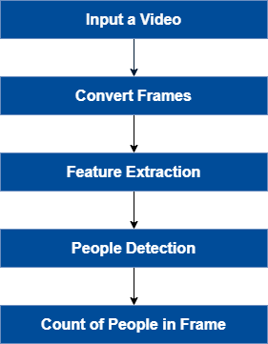
ARCHITECTURE
Why Should I Study this course?
Examples
BVRIT HYDERABAD College of Engineering for Women

Slide 4
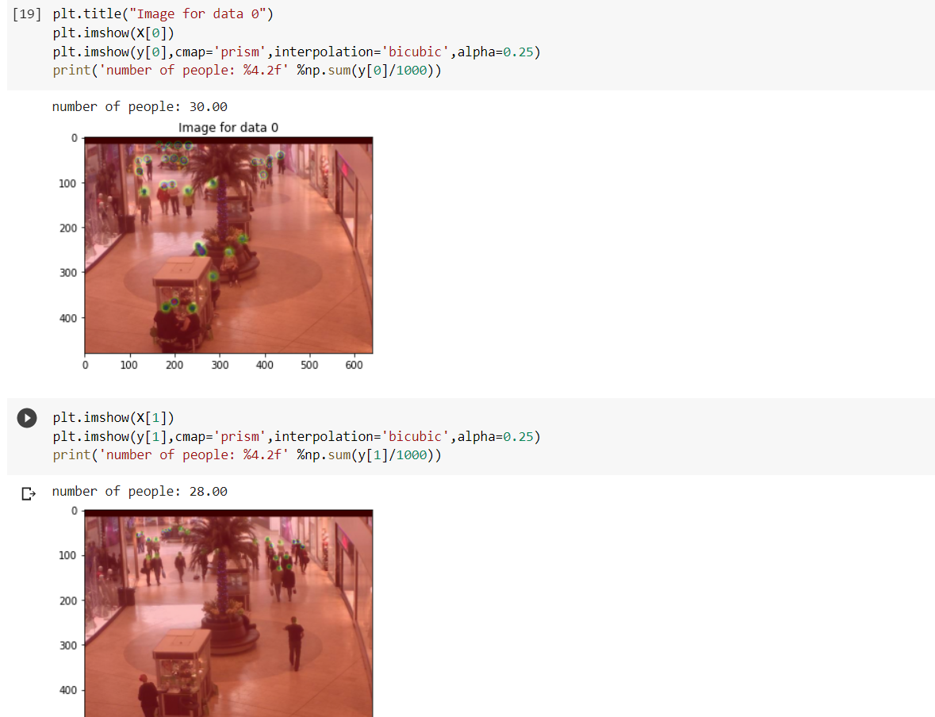
OUTPUT
Why Should I Study this course?
Examples
BVRIT HYDERABAD College of Engineering for Women

Slide 5
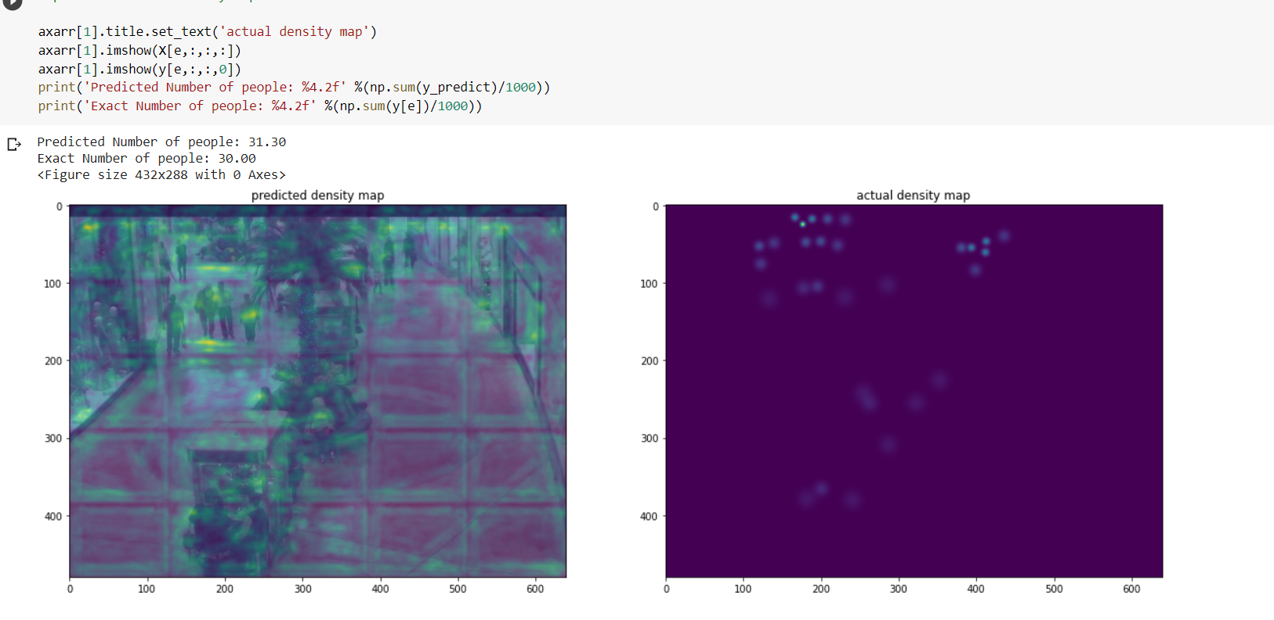
OUTPUT
Why Should I Study this course?
Predicted Number of People and Actual Number of People
Examples
BVRIT HYDERABAD College of Engineering for Women

Slide 6
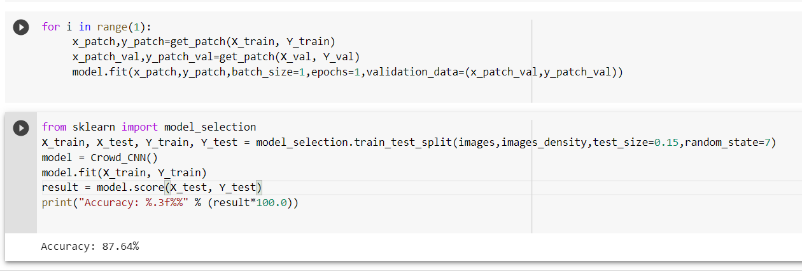
ACCURACY
Why Should I Study this course?
Examples
BVRIT HYDERABAD College of Engineering for Women

Slide 7
Thank you

